Slide 1




VIDYA JYOTHI
SKILL DEVELOPMENT COURSE
INSTITUTE OF TECHNOLOGY
UI DESIGN -
FLUTTER
WEEK-01
INSTALLATION OF ANDROID STUDIO & FLUTTER

Slide 2
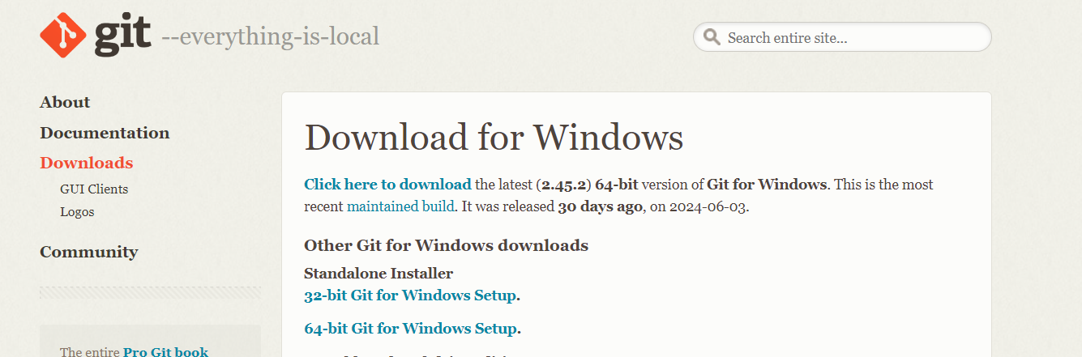

Step 1: System Requirements
Operating System: Windows, macOS, or Linux
Disk Space: At least 1.64 GB (excluding IDE/tools)
Tools: Git for Windows,
Install Git from the Official Website. (Download 64-bit Git).

Slide 3
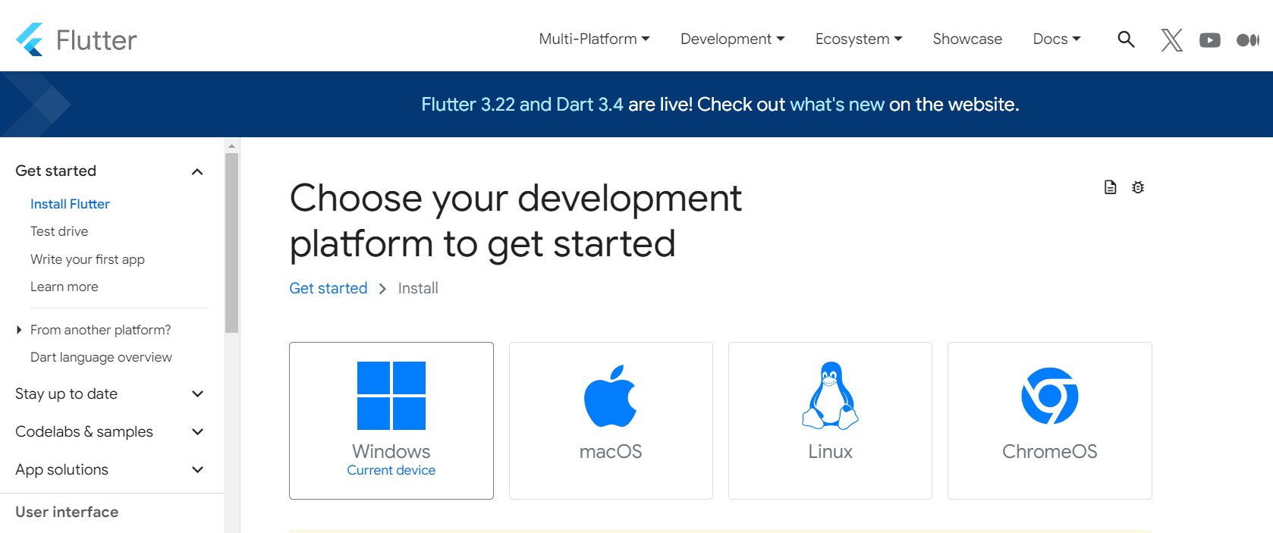
Step 2: Download Flutter SDK
Go to the Flutter SDK download page.
Select your Development Platform.

Slide 4
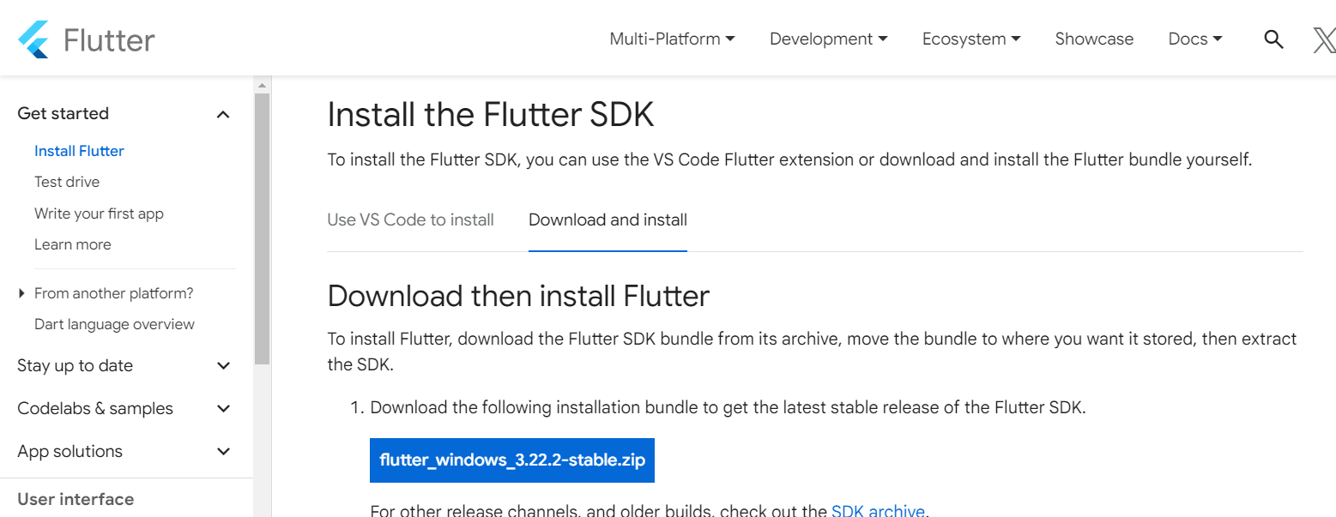
Download the latest stable version.

Slide 5
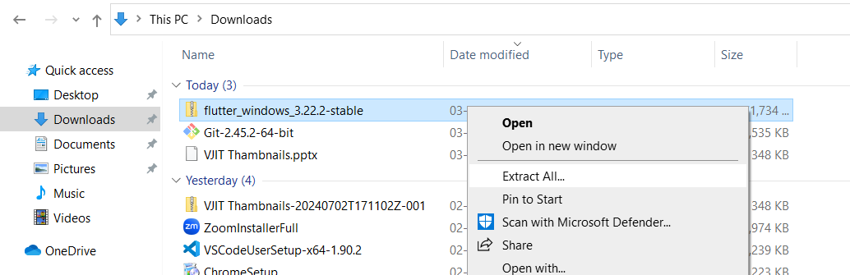
Extract the zip file to a suitable location on your machine.
Once Extraction is Complete you will be having the flutter folder. The folder just cut it and pasted to Local Disk.
(e.g.,’C:\src\flutter’ on Windows or ‘~/development/flutter’ on macOS/Linux).

Slide 6
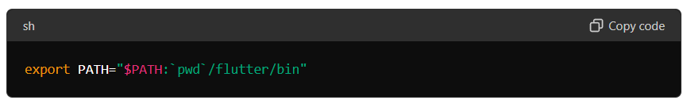
Step 3: Update Path Environment Variable
On Windows:
You need to add the flutter path in the environment vaiable.
Path : C:\src\flutter\bin
Go to search and type environment you’ll be the having the edit the system environment variable.
In the Environment variables section, find the Path variable and click Edit.
Add the full path to the flutter\bin directory (e.g., C:\src\flutter\bin).
On macOs/Linux:
Open your terminal and run:

Slide 7
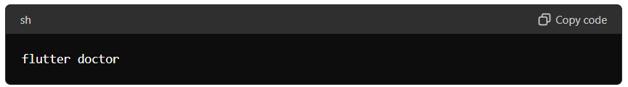
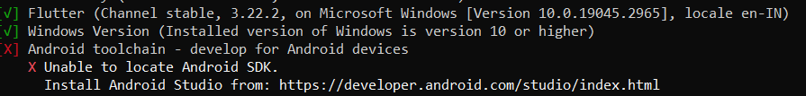
Step 4: Verify Installtion
Open a new terminal (or command prompt) and run.
After Verification, we will be getting welcome to flutter which means that we have done all the necessary things.
we are getting this particular error because we haven’t installed Android studio. This is going to be the Next step...

Slide 8
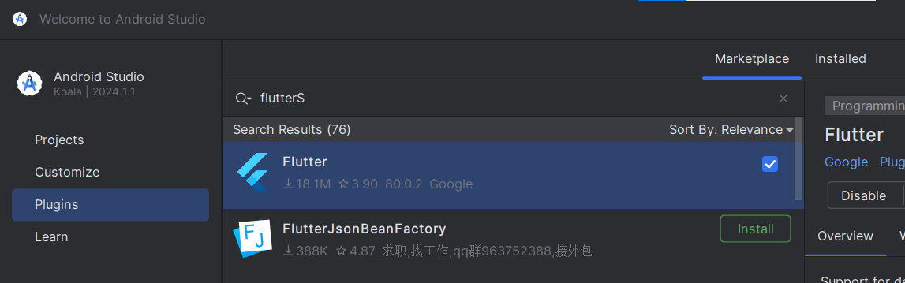
Step 5: Install Android Studio.
Go to Android studio official page and download it.
Do Android studio setup.
Open Android Studio.
Go to Plugins and Search for and install the Flutter plugin.

Slide 9
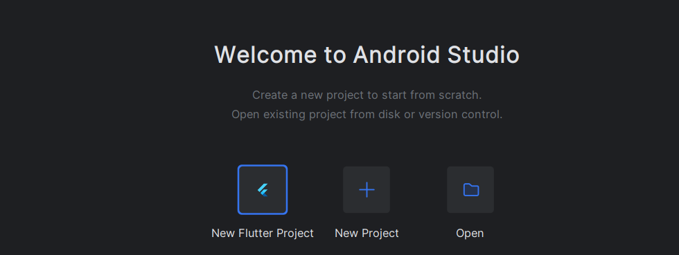
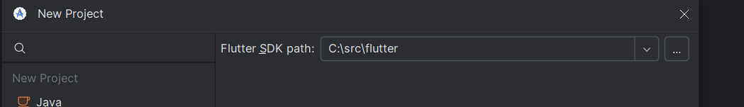
Step 6: Create and Run a New Flutter Project
Click New Flutter Project.
Select Flutter, and we need to give Flutter SDK Path.
and Click Next. Here, we need to give Project Name then enter OK.
Successfully Created first flutter project..

Slide 10
THANKYOU
MahesH
it solutions

